Slide 1
SQL CREATe & POPULATE tables
Here are screenshots of SQL DDL statements in Microsoft SQL Server Management Studio to create several tables, indicating the primary and foreign keys, constraints, and attribute characteristics and then insert data into those tables

Slide 2
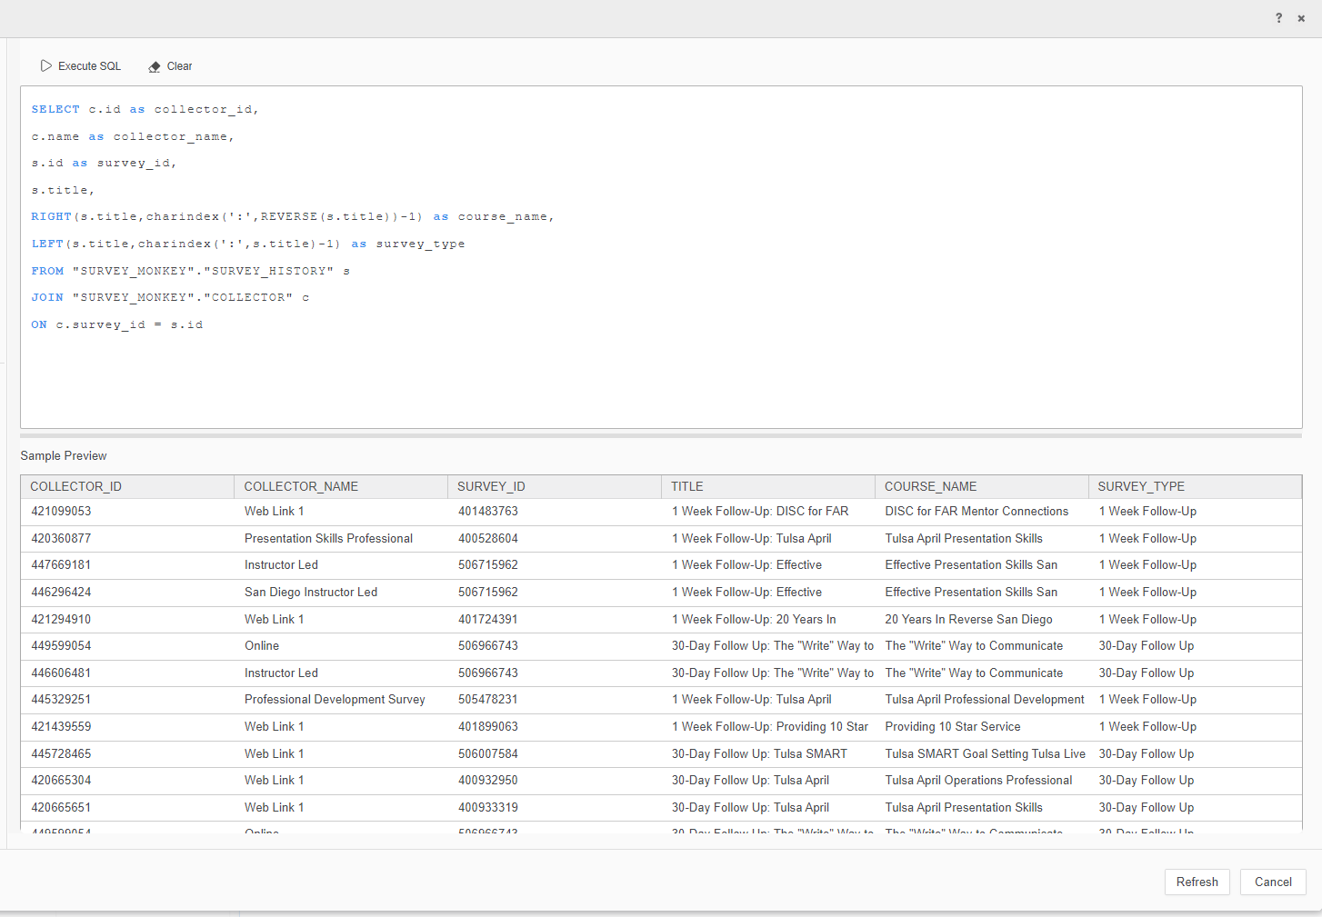
--Joining fields from survey history and collector tables from SurveyMonkey into Microstrategy; Used RIGHT and LEFT commands to split one column into two variables

Slide 3
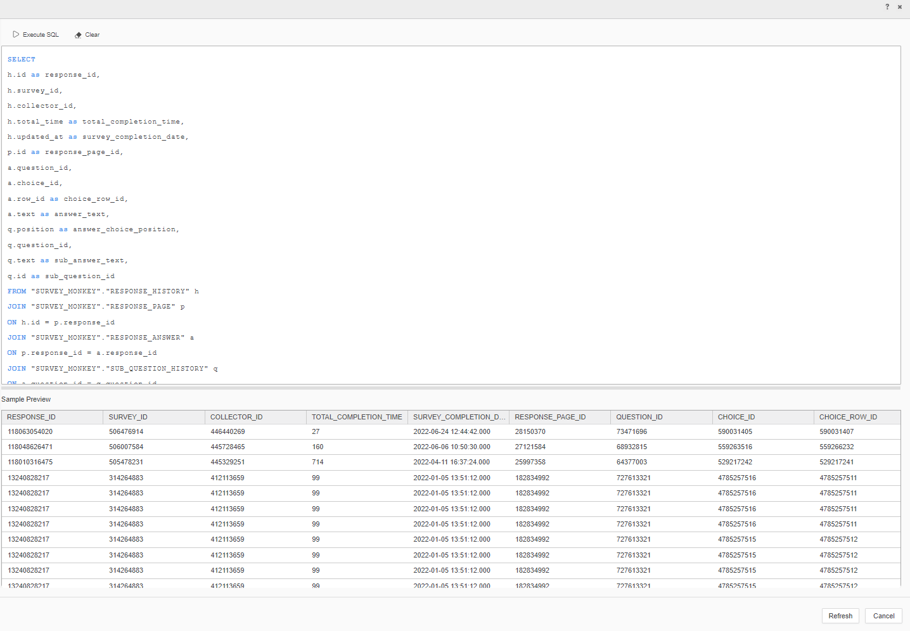
--Joining fields from 4 separate tables using SQL DML

Slide 4
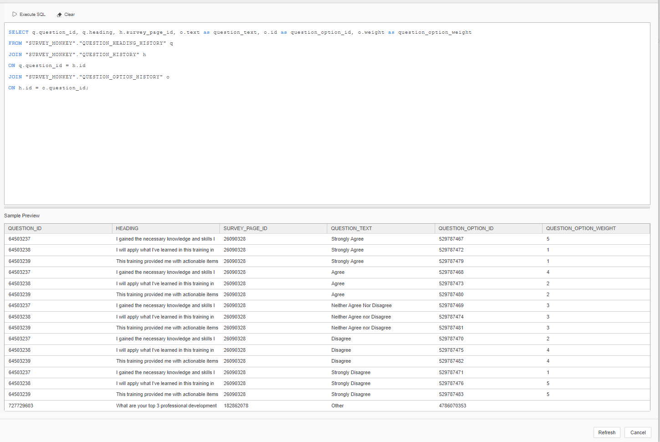
--Joining fields from three question-related tables from SurveyMonkey to utilize within Microstrategy

